Slide 1

Синхронизация времени для электронной торговли

Slide 2
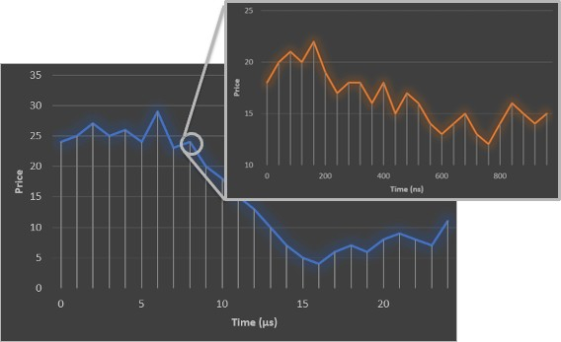
Примеры использования электронной торговли
В основе электронных торговых сетей
Задержка
Оптимизация
Видимость сети
Качество данных
Точность временных меток
Распределенные стратегии
Регулирование
Устойчивость

Slide 3





Синхронизация времени в финансовой сфере
Отслеживаемая синхронизация - это возможность поддерживать общее представление о времени, связанное с официальным отсчетом времени, между различными устройствами, расположенными в одном и том же или разных местах.
Генерация: это способность получать представление о времени.
GPS, atomic clocks.
Распространение: это возможность передавать представление о времени на другое устройство.
NTP, PTP, WR, PPS

Slide 4
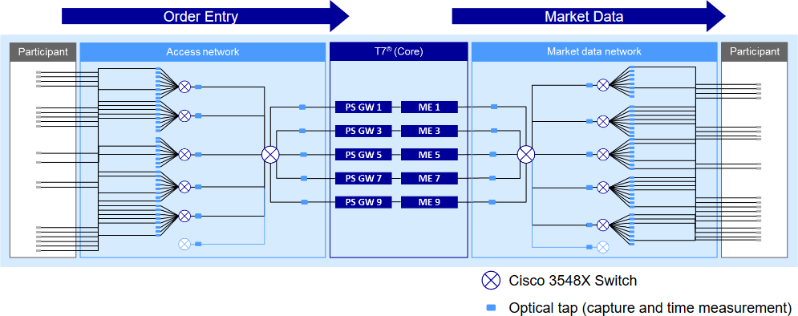
Синхронизация времени в финансовой сфере
Как выглядит сеть фондовых бирж?

Slide 5



Синхронизация времени в финансовой сфере
Фондовая биржа (SE)
Торговая система
SE – GNSS/AC source LAN sync
PAR - GNSS source
SE – PAR sync EX – PAR sync
Data links
Участник
(PAR)

Slide 6
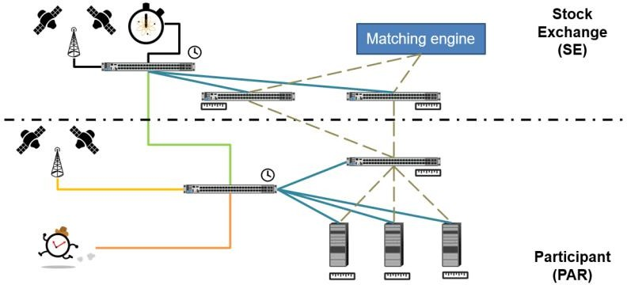
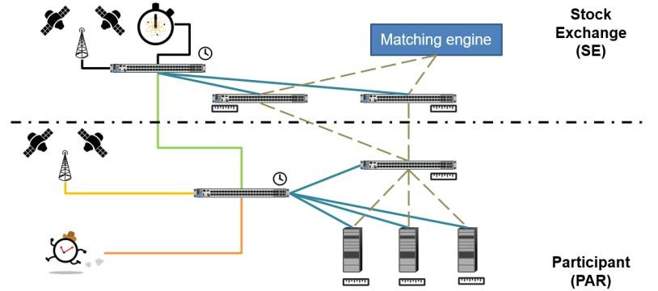

Синхронизация времени в финансовой сфере
Финансовый хаб

Slide 7
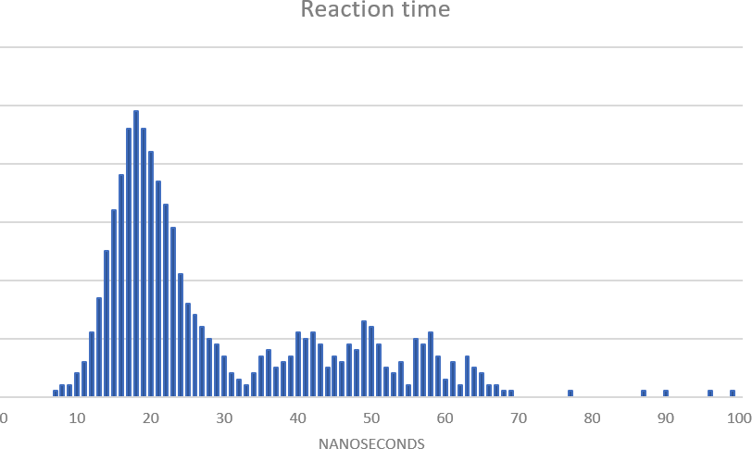
Синхронизация времени в финансовой сфере
Измерение задержки: Абсолютное время реакции на рыночные события колеблется от 15 до 70 наносекунд. Основная волна: 20 ±10 нс.
Временная погрешность от пика до пика в 5 нс означает 50%-ную неопределенность в измерении.
Качество данных: обучение ИИ с неправильными значениями задержки влияет на точность результатов. Даже если вы не заинтересованы в проведении гонки с низкой задержкой, синхронизация времени и захват данных являются важными инструментами для повышения вашей прибыльности.

Slide 8
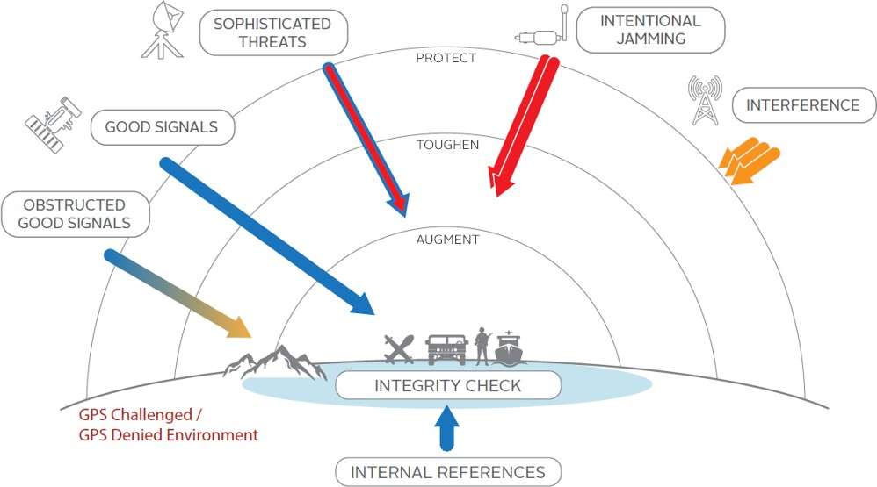
Угрозы отказоустойчивости ГНСС

Slide 9

Лучшие практики обеспечения отказоустойчивости сети
Чего следует избегать?
Зависимость от GNSS: подвержена глушению, подмене и непреднамеренным помехам.
Единый источник времени: только один источник времени не гарантирует
точное время и подвергает риску вашу сеть.
На что обратить внимание?
Избыточность сети: Отдельные точки отказа повышают вероятность of major failures.
Отслеживаемость: Синхронизация времени должна быть проверена, особенно при работе с чисто программными решениями.
Закон Сигала:
“Человек с часами знает, который час. Человек с двумя часами никогда не бывает уверен”.
Прибыльность: Развертывание резервных копий синхронизации может стать возможностью улучшить вашу торговлю.

Slide 10

Background to White Rabbit

Slide 11

Terminology
Accuracy
The degree to which the result of the time conforms to the correct value or standard
Precision
The degree of repeatability of different results of the time
Low accuracy
Low precision
High accuracy
Low precision
Low accuracy
High precision
High accuracy
High precision

Slide 12






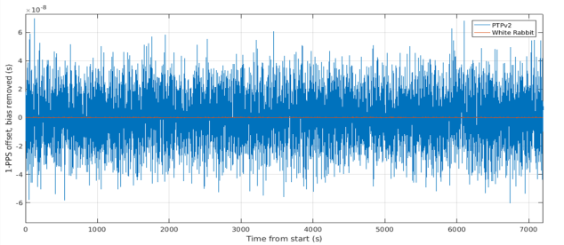
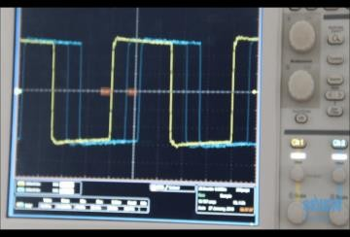
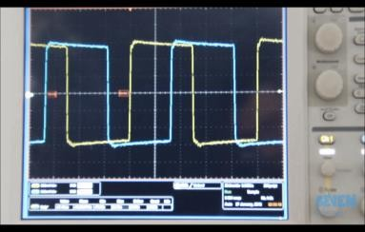
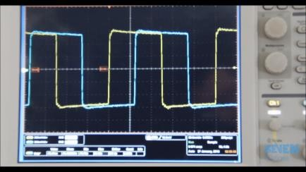

Intro to White Rabbit
Scalable
Easy integrable
Easy to deploy
Ultra-high accurate
Enables new
applications
White Rabbit is a synchronization protocol which enables sub- nanosecond accuracy time transfer and frequency distribution over optical fiber links.
It is based on L1 syntonization for frequency distribution and
enhanced implementation of PTP for improved timestamps and
Dependable
asymmetry control.
Born at CERN for scientific applications and translated to industrial
market by 7Sols/Orolia/Safran.
It is now part of IEEE1588-2019 (PTP), as High Accuracy profile.
Syntonization – Sync E
Synchronization – enhanced PTP

Slide 13
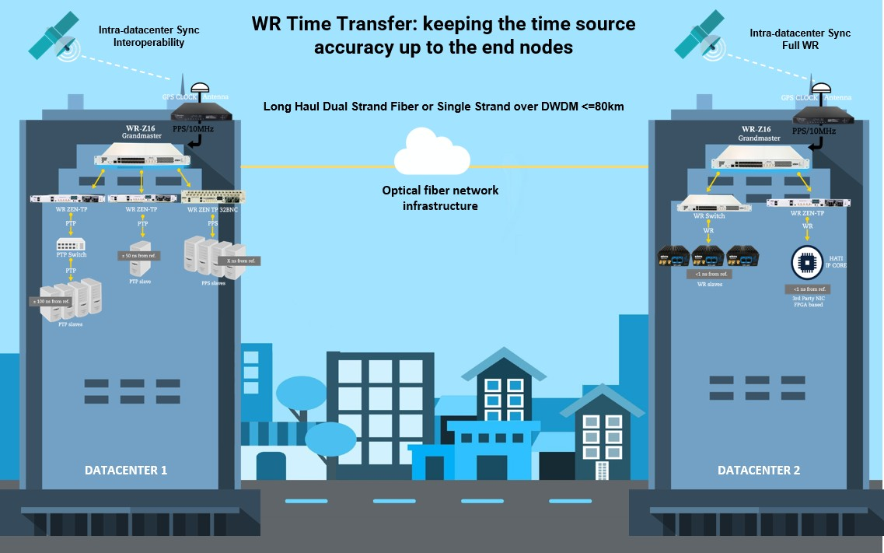
White Rabbit value proposition
Ultra-accurate sub-ns Time transfer
Timestamping optimization (Latency
measurement, data fusion, etc.)
Low Phase Noise Frequency distribution
Distributed systems (Sensors)
Long-distance sync and scalability
Intra and Inter Datacenter deployments (local/
wide area networks)
Network resiliency
GNSS backup/ complement & GNSS denied
Precise Monitoring
Time references monitor and evaluation
High Accuracy IP core (HATI) integrable into third party HW
Interoperability with timing interfaces
Time error optimization
PTP, NTP, Sync-E, IRIG, 1PPS, 10MHz, etc.
Time as a Service (TaaS) enabler

Slide 14
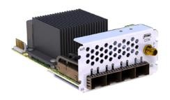
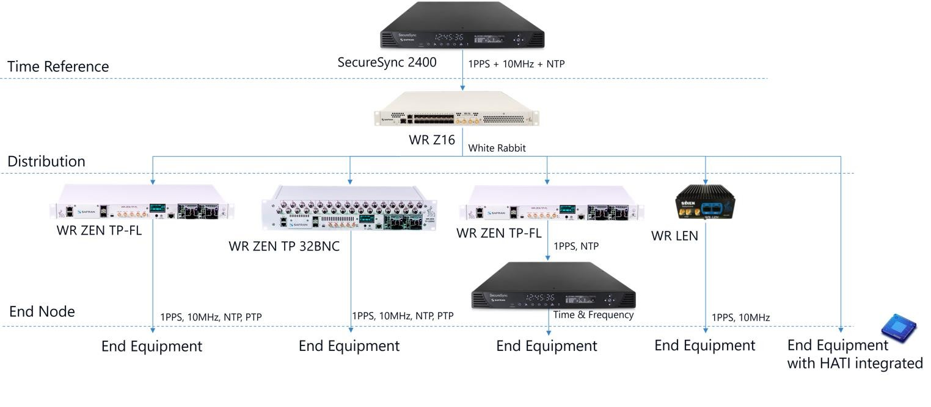

White Rabbit distribution ecosystem
1PPS, 10MHz, NTP
or WR (via WROX)

Slide 15

White Rabbit for Electronic Trading

Slide 16

White Rabbit for Finance
 Better accuracy and precision between trading sites
 White Rabbit over DWDM
 i.e. NJ triangle, Aurora & Cermak
 Auto failover between GPS at different sites
 Ideal if not all sites have GPS capability
 Simplifying existing PTP network design
 White rabbit to existing PTP slaves or end clients
 Better accuracy
 <1ns between White rabbit devices
 Leveraging HATI IP core for direct access to White Rabbit from FPGA application

Slide 17
White Rabbit for Finance
 Higher accuracy & precision with timestamping cards or switches
 White Rabbit PPS output to top of rack with <1ns sync
 Ideal when distribution of timestamping switches are physically distanced from time reference
 Addition of holdover to existing time source references
 < 1μs drift over 24 hours
 Protect against catastrophic failures
 Receiving a White Rabbit feed from an exchange as a time service
 No need for roof antenna, local infrastructure etc.
 e.g. Deutsche Börse White Rabbit time service
https://www.deutsche-boerse.com/dbg-en/products-services/ps-technology/ps-connectivity-services/ps-connectivity-services-time-services

Slide 18
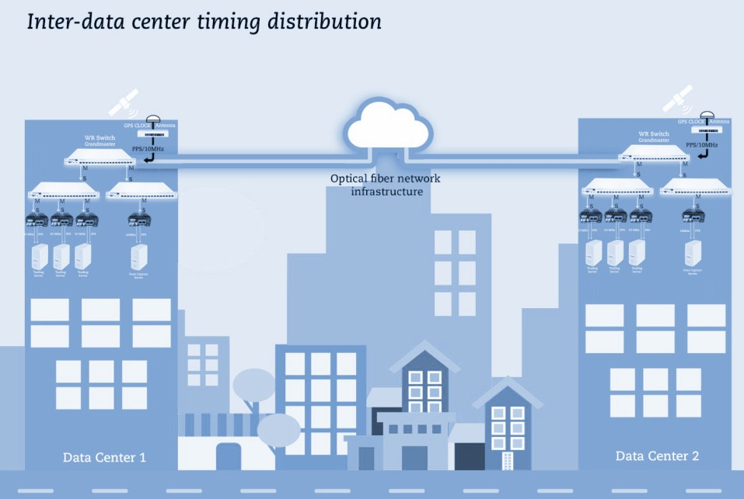
Sub-nano metro area timing distribution
 Sub-nanosecond synchronization between
different datacenters.
 Thousands of synchronization nodes.
 NTP, PTPv2 and PPS local distribution.
 Backup to GNSS time over fiber.

Slide 19
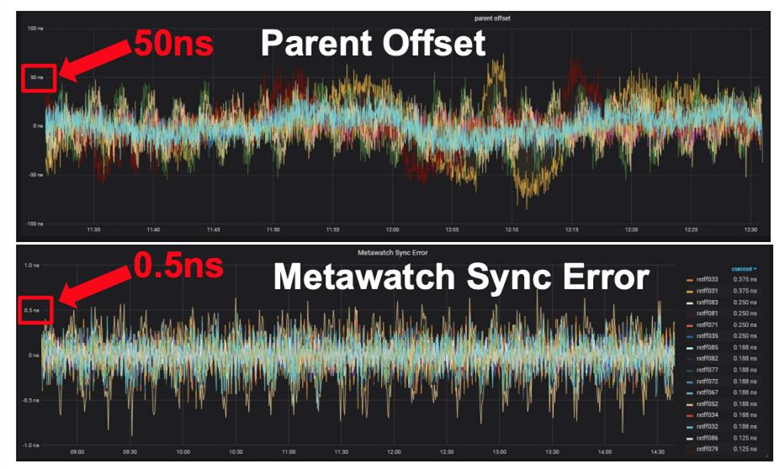
White Rabbit vs PTP
PTP
White Rabbit

Slide 20
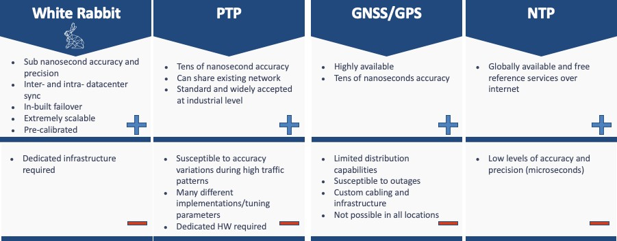
White Rabbit vs other technologies

Slide 21
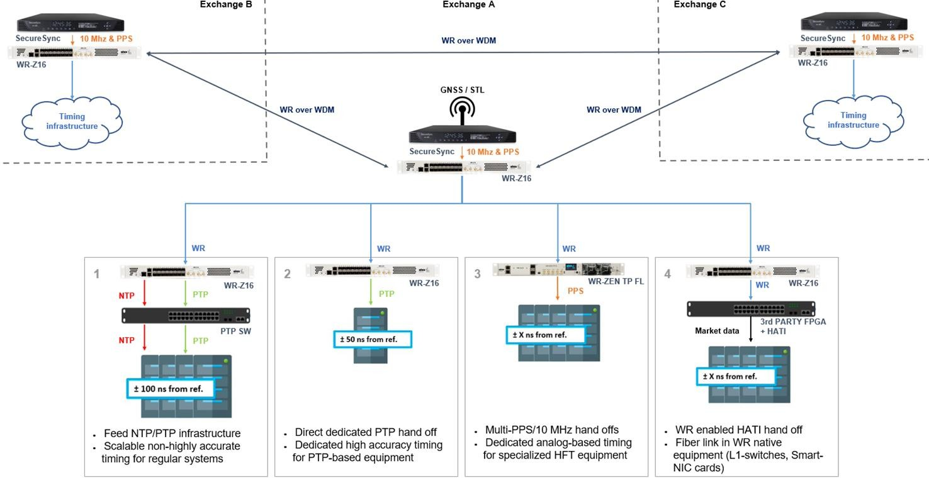
Data center Time Distribution

Slide 22
White Rabbit Metro Time Distribution

Slide 23
Proprietary trading firm (1/2)
 Deployed White Rabbit to improve accuracy and precision for internal
timestamping
 Resilience between sites and time sources a key requirement
 Not all sites had GPS capability/accessibility
 Leveraging FPGA based timestamping switch to accurately timestamp at
network points
 PPS input to switches
 Desired improvement with existing PTP services without replacing existing network
 PPS where high sub-nano accuracy needed <1ns
 PTP to existing infrastructure with <30 ns accuracy

Slide 24
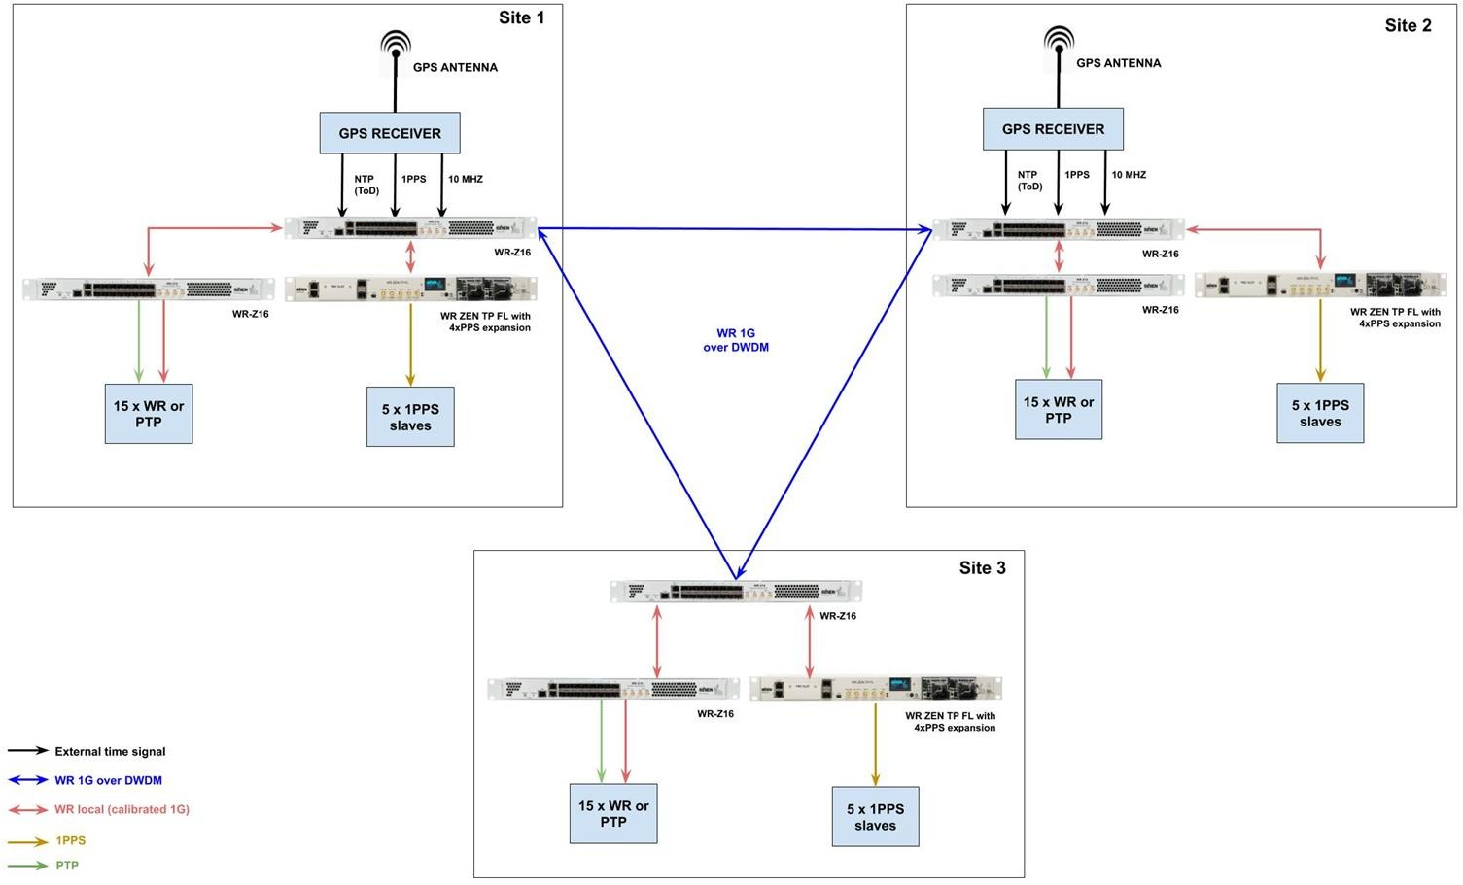
Proprietary trading firm (2/2)

Slide 25
White Rabbit for Exchanges
More accuracy & precision for internal timestamping
 Know when packets were received at gateways, matching engine, distribution
points
 Accurate visibility on how long each component takes
 Advanced knowledge of client tick-to-trade times
 Better monitoring, operational capability and management
Increased time synchronization resilience
 Protect against GPS jamming and component failures
 Protect against catastrophic failures
Using White Rabbit to generate exchange revenue with additional services
 White Rabbit precisely synchronized timestamping data files
 White Rabbit time feeds

Slide 26
Case studies

Slide 27
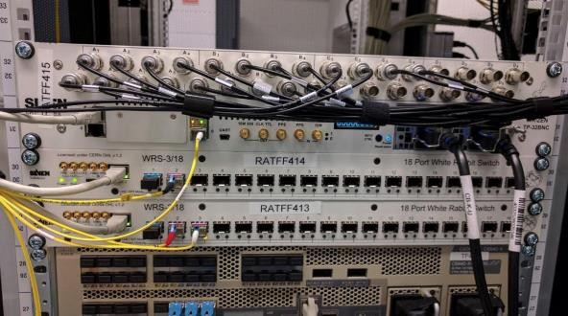
Case Study: Deutsche Börse
Using White Rabbit in conjunction with Arista 7130
 PPS output from White Rabbit to PPS input for Arista 7130
Timestamping all customer cross-connects in co-location
 500+ capture ports, 60+ capture devices, 4 data center modules
 Allows for detailed analysis of bursts
High Precision Timestamp File as a commercial service
 Provide network timestamps to trading participants
Order entry and market data
Analysis of where each participant executes compared to competition
Utilized for backtesting with highest timestamp quality
High Precision Time Service as a commercial service
 White Rabbit colocation hand-off
https://stacresearch.com/system/files/resource/files/STAC-Summit-15-Nov-2018-White%20Rabbit.pdf

Slide 28
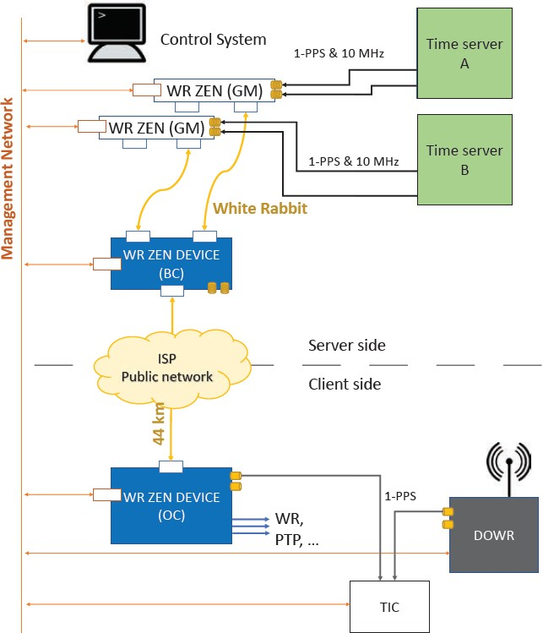
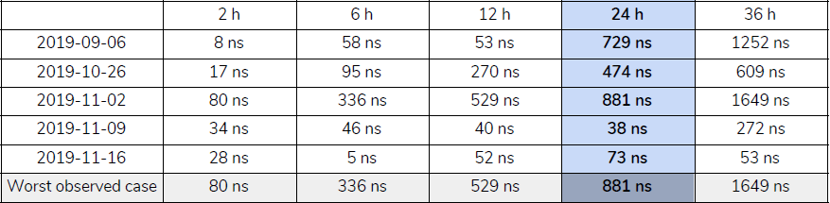
Case Study: Spanish Stock Exchange
Redundant time references.
Sub-nanosecond synchronization over a 44
km fiber link (27 miles).
± 15 nanoseconds traceability to UTC using the DOWR.
Holdover capabilities if the link is lost.

Slide 29
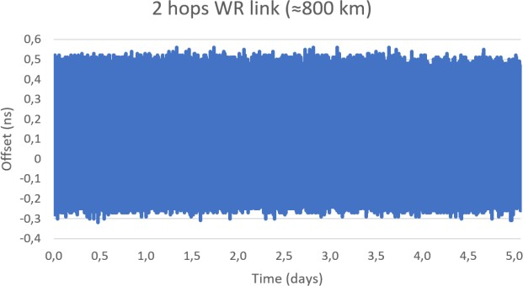
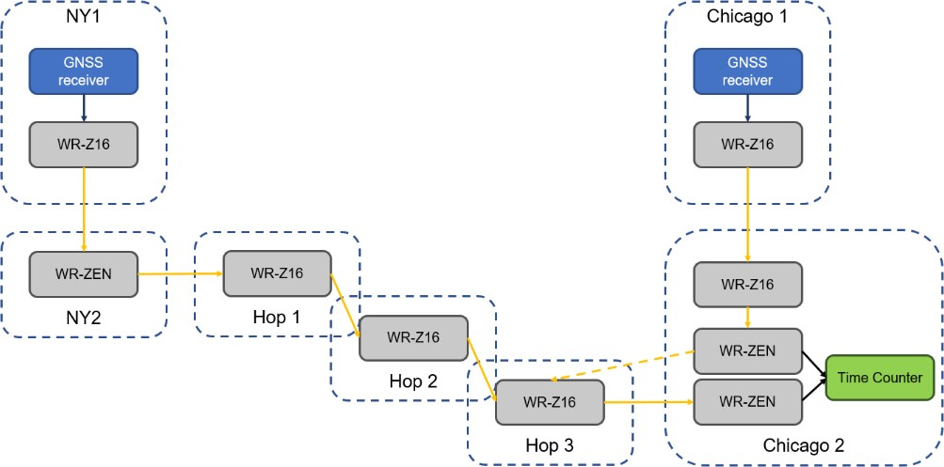
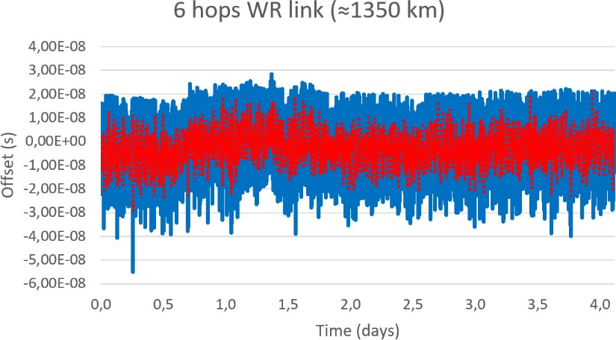
Case Study: Optiver - NJ to Chicago link
Longest White Rabbit link ever deployed.
Nanosecond-level synchronization achieved.

Slide 30
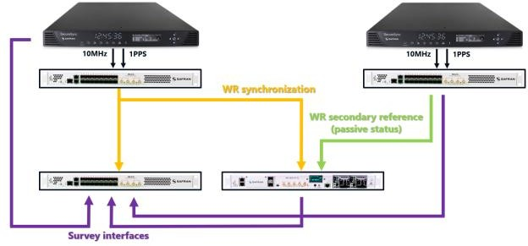
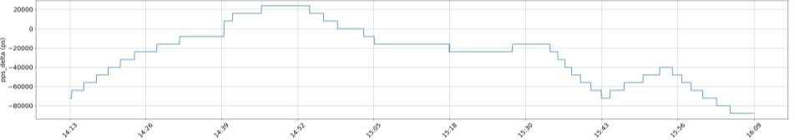
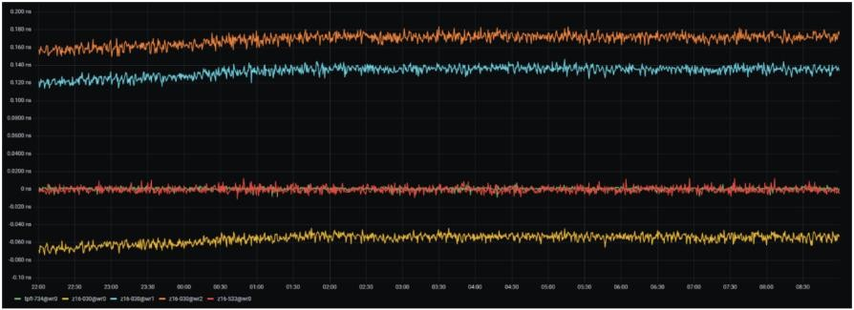

Case Study: Survey measurement
Real-time measurement of active, backup and survey references.
Picosecond-level offset and delay measurement between sources.
Sub-nanosecond synchronization between multiple devices.
Interoperable with White Rabbit, PTP, NTP and 1PPS/10 MHz.
Historic collection of metrics for 7 days.
Distributed picosecond-level time offset monitoring in White Rabbit High Accuracy synchronization networks in a datacenter scenario
In collaboration with Equinix at ISPCS 2024

Slide 31
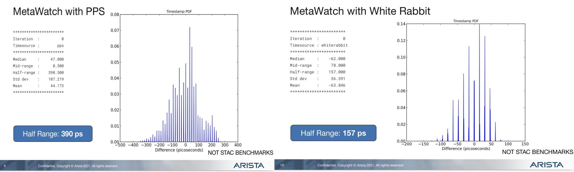
Case Study: WR integration in Arista 7130 L1 switch
Proprietary HATI IP core running on Arista 7130 devices to achieve sub-nanosecond accuracy.
Distribution over fiber without calibration and native integration with MetaWatch timestamping application.
▪ Available to anyone who wants to develop a custom a
pplication
Publicly announced years ago and part of the default firmware release for Arista

Slide 32

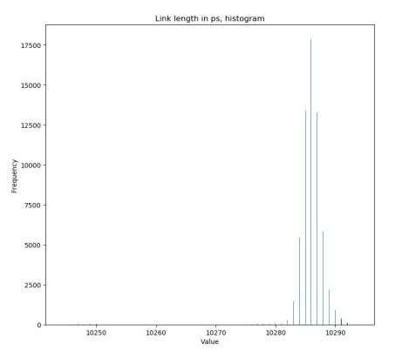
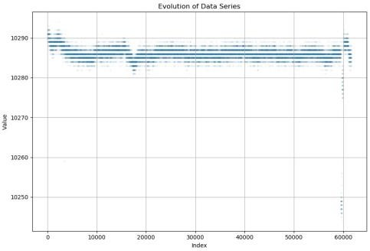
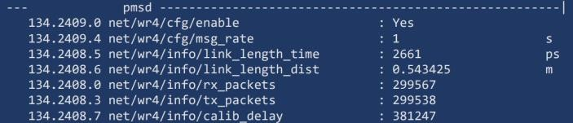
Case Study: Latency measurement
Measure the latency of the optical medium with a precision of
less than 50 ps.
Use of off-the-shelf network equipment and standard Ethernet
traffic.
Latency measured thousands of times per second and reported on real-time to avoid fiber tampering.
PoC validated in a production scenario for a financial customer

Slide 33
Product Family

Slide 34
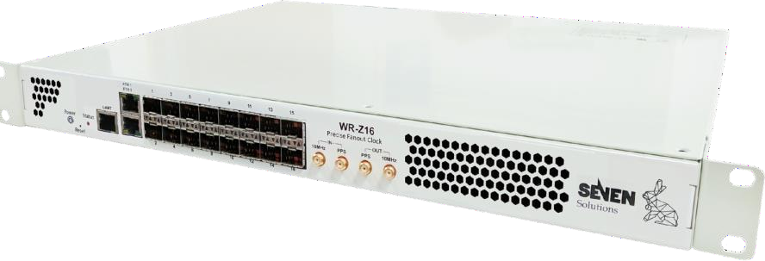

White Rabbit Z
Multi-port synchronization fanout.
16 x WR, HATI, IEEE 1588 PTPv2 and NTP interoperability
optical interfaces.
Multi-source time references.
Failover mechanisms.
Automatic switchover.
Holdover.
Time traceability for regulatory purposes.
Extended monitoring and management tools
(Authentication, SNMP, security…).
Redundant power supply and fans.
Serial and Ethernet RJ45 ports.
The reliable precise time fan-out for White Rabbit distribution on 1G Ethernet-based networks.
▪ Additional features to come!

Slide 35
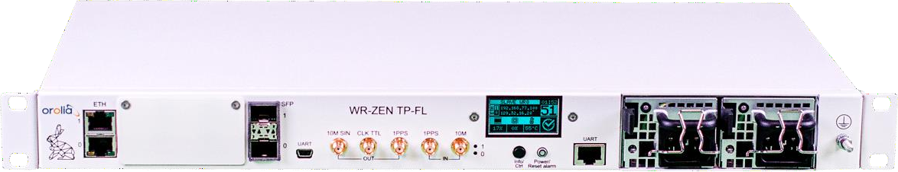

WR-ZEN TP-FL
Standalone White Rabbit distribution.
2 x WR, IEEE 1588 PTPv2 and NTP interoperability optical interfaces.
Redundant White Rabbit or 10MHz & PPS inputs
10 Mhz, PPS and CLK outputs
Redundant power supply and fans.
Serial and Ethernet RJ45 ports.
4 or 8 port SMA PPS expansion boards supported (factory installed).
Extended monitoring and management tools (Authentication,
SNMP, security…).
The fundamental standalone node that provides the White Rabbit features to a wide range of applications making use of its redundant connections.

Slide 36

High Accuracy Timing IP Core (HATI)
High Accuracy timing integration in Xilinx FPGAs (including US+).
Sub-nanosecond time accuracy on L1 switches and NICs.
No need for expensive oscillators/clocks.
Distribution over fiber without calibration.
FPGA core intended to enable sub-nanosecond synchronization accuracy to a third-party hardware.

Slide 37
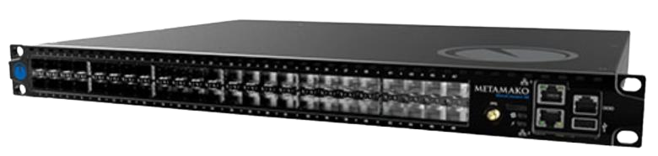
HATI Core: Arista 7130
Sub-nanosecond time accuracy on Arista 7130.
Supported on 7130LB models.
Distribution over fiber without calibration from the WR- Z16.
Working with Arista to integrate HATI and 7130
applications.
Available to anyone who wants to develop a custom application.

Slide 38
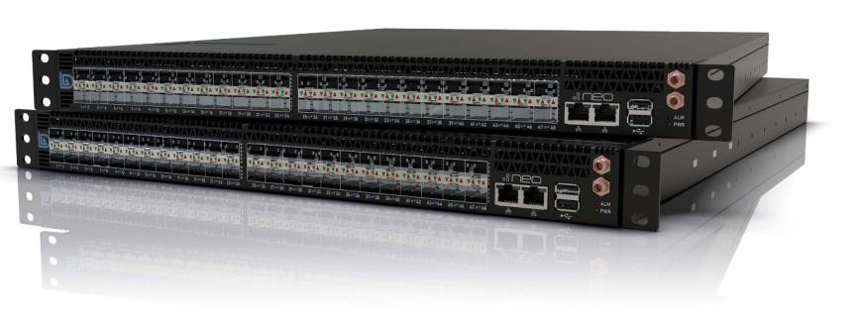
HATI Core: LDA Technologies NeoTap
Sub-nanosecond time accuracy on LDA Technologies NeoTap.
Working with LDA Technologies to integrate HATI and
NeoTap applications.
Distribution over fiber without calibration from the WR-Z16.
Available to anyone who wants to develop a custom application.

Slide 39
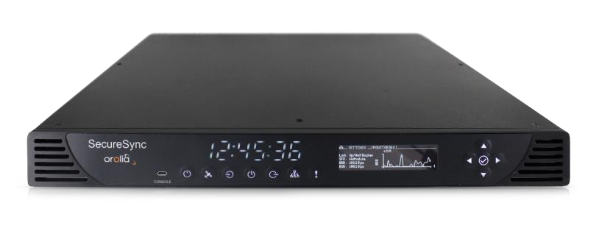
SecureSync®
Industry-Leading & Modular Resilient Time & Frequency Synchronization Platforms
Synchronize to GPS, SAASM GPS, Galileo, multi-GNSS
and many other timing references
Generate virtually any time and frequency output signals
Multiple internal oscillator options
Built-in high-performance NTP server; PTP options
Modular (configure-to-order) ruggedized shock
and vibration-tested chassis (1RU)
Exceptional operating temperature range of -20°C to +65°C
Secure network management and control
Platform approach allows easy integration of specific capabilities
Time & Frequency Reference Solution

Slide 40


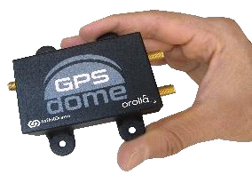





preventing interferences at antenna level
Passive Anti-jam antenna 8230AJ
Horizon blocking antenna
GPS Dome
Null steering in direction of interference
⇒ Both anti-jam antenna 8230 and GPS dome can be combined for higher interference rejection
⇒ Safran works also on CRPA antenna (longer-term projects)

Slide 41
Use Cases

Slide 42

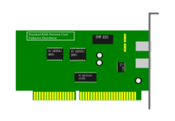

Key to diagrams
Hardware
SecureSync 2400: Accurate, secure, timing / GNSS receiver
White Rabbit Z16: reliable precise time fan-out for White Rabbit distribution on 1G Ethernet-based networks.
White Rabbit Zen TP-FL: standalone node that provides the White Rabbit features to
a wide range of applications
PTP or HATI enabled Switch
Network Interface PCIe Card (NIC) or Field Programmable Gate Array (FPGA) PCIe Card
Data sources & Flows
GNSS/GPS Antenna
Site or location boundary
10 Mhz timing signal
White Rabbit over fiber
1 PPS timing signal
PTP over fiber

Slide 43
WR to PTP Switch
Simple addition to existing PTP design.
Introduces White Rabbit to the network without requiring any changes.
Can co-exist with other PTP services using the best master clock algorithm.
Improvement over existing PTP design with ±50ns from reference to PTP device.
No downstream change to end client applications but allows an adoption of White Rabbit as a starting point for other timing projects or use-cases.
Standard fiber deployment, no special cabling, optics or calibration
required.
SecureSync 2400
10Mhz 1 PPS
WR Z16
PTP
PTP Switch

Slide 44
WR to PTP card/NIC
Simple addition to existing network design
Introduces White Rabbit to the network without requiring any changes
Can co-exist with other PTP services using the best master clock algorithm
Approx. ± 50ns from reference direct to NIC
± 20ns from reference with tuned Solarflare
No downstream change to end client applications but allows an adoption of White Rabbit as a starting point for other timing projects or use-cases.
Standard fiber deployment, no special cabling, optics or calibration
required.
SecureSync 2400
10Mhz 1 PPS
WR Z16
PTP
NIC

Slide 45
WR to HATI enabled Switch
Sub-nanosecond level timing to HATI enabled switch.
Works with Arista 7130LB series running MetaWatch.
Distribution over standard fiber from the WR-Z16 with no calibration
required. Pre-calibrated optics.
SecureSync 2400
10Mhz 1 PPS
WR Z16
WR
HATI enabled switch

Slide 46

WR to FPGA card with HATI
Sub-nanosecond level timing to HATI core on a Xilinx based FPGA card.
No need for expensive oscillators/clocks directly on FPGA card.
Distribution over standard fiber from the WR-Z16 with no calibration required. Pre-calibrated optics.
SecureSync 2400
10Mhz 1 PPS
WR Z16
WR
FPGA Card

Slide 47
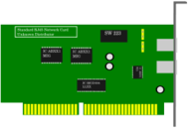
WR to PPS device
Suitable for network cards and switches that require 1 PPS handoff.
White Rabbit (WR ZEN TP-FL) converts to 1 PPS at the local rack, and can hand off 1 PPS.
White Rabbit links as sub-nanosecond accuracy.
Handoff from 1 PPS on WR-ZEN TP-FL are sub-nanosecond accuracy.
Distribution between White Rabbit nodes over standard fiber from
the WR-Z16 with no calibration required. Pre-calibrated optics.
Any inaccuracy introduced will be based on either coaxial cable variance or receiving hardware.
SecureSync 2400
10Mhz 1 PPS
WR Z16
WR
WR-ZEN TP-FL
1 PPS
1 PPS

Slide 48
WR where GPS is not available
Suitable for sites without local GNSS/GPS access.
White Rabbit signal delivered from Site A -> Site B over DWDM or fiber.
Sub-nanosecond accuracy.
Calibration required between sites, performed by Orolia team.
Output from WR Z16 may be WR, PTP or 1 PPS.
No retiming should happen on the optical path.
SecureSync 2400
10Mhz 1 PPS
WR Z16
WR Over DWDM or Fiber

Slide 49
WR redundancy at single site
WR Z16’s can be configured to have multiple prioritized input sources of time.
Multiple time references may be used to create WR Z16 devices redundancy.
Each WR Z16 can provide time at sub-nanosecond accuracy to another.
Distribution between White Rabbit nodes over standard fiber from the WR-Z16 with no calibration required. Pre-calibrated optics.
SecureSync 2400 SecureSync 2400
10Mhz 1 PPS 10Mhz 1 PPS
WR Z16 WR Z16
WR

Slide 50
WR backup from 2nd site
WR Z16’s can be configured to have multiple prioritized input sources of time.
Each WR Z16 can receive White Rabbit signal from another site to provide a 2nd source of time in the case of component failure.
Calibration required between sites, performed by Orolia team.
Output from WR Z16 may be WR, PTP or 1 PPS.
No retiming should happen on the optical path.
Site A
Site B
SecureSync 2400 SecureSync 2400
10Mhz 1 PPS 10Mhz 1 PPS
WR Z16 WR Z16
WR Over DWDM or Fiber

Slide 51
WR from exchange/service provider
Direct White Rabbit handoff from an exchange or service provider.
No GNSS/GPS equipment required.
Distribution over standard fiber from the WR-Z16 with no calibration required.
Pre-calibrated optics, with service provider using one color on a wavelength and the end-user the other.
Output from WR Z16 may be WR, PTP or 1 PPS.
Can be used as a redundancy source along with typical GNSS/GPS or PTP.
Exchange/Provider handoff
WR
WR Z16

